Slide 1
Iot protocol

Slide 2
Data Link Communication Protocol
The IoT Data Link communication protocol provides service to the Network Layer. There are various protocols and standard technologies specified by the different organization for data link protocols.
Bluetooth
Bluetooth is a short-range wireless communication network over a radio frequency. Bluetooth is mostly integrated into smartphones and mobile devices. The Bluetooth communication network works within 2.4 ISM band frequencies with data rate up to 3Mbps.

Slide 3
Properties of Bluetooth network
Standard: Bluetooth 4.2
Frequency: 2.4GHz
Range: 50-150m
Data transfer rates: 3Mbps
Advantages of Bluetooth network
It is wireless.
It is cheap.
It is easy to install.
Disadvantages of Bluetooth network
It is a short-range communication network.

Slide 4
IoT Network Layer Protocols
The network layer is divided into two sublayers: routing layer which handles the transfer of packets from source to destination, and an encapsulation layer that forms the packets
RPL Protocol
RPL stands for Routing Protocol for Low-Power and Lossy Network. It is a distance-vector protocol that supports a varity of Data Link Protocols. RPL builds a Destination Oriented Directed Acyclic Graph (DODAG) which has only one route from each leaf node to the root. All the traffic in this DODAG is routed through the root. Initially, each node sends a DODAG Information Object (DIO) announcing them self as a root. This information travels in the network, and complete DODAG is gradually built. When a new node wants to join the network, it sends a DODAG Information Solicitation (DIS) request and root responds back with a DAO Acknowledgment (DAO-ACK) confirming the join.

Slide 5
CORPL Protocol
CORPL protocol is the extension of the RPL protocol, which is termed as cognitive RPL. This network protocol is designed for cognitive networks and uses DODAG topology. CORPL protocol makes two new modifications in the RPL protocol. It uses opportunistic forwarding to forward a packet between the nodes. Each node of CORPL protocol keeps the information of forwarding set rather than parents only maintaining it. Each node updates its changes to its neighbor using DIO messages. On the basis of this updated message, each node frequently updates its neighbor for constant forwarder set.
CARP Protocol
CARP (Channel-Aware Routing Protocol) is a distributed routing protocol. It is designed for underwater communication. It has lightweight packets so that it can be used for Internet of Things (IoT). It performs two different functionalities: network initialization and data forwarding. CARP protocol does not support previously collected data. Hence, it is not beneficial for those IoT or other application where data is changed frequently. The upgradation of CARP is done in E-CARP which overcomes the limitation of CARP. The E-CARP allows the sink node to save previously received sensory data.

Slide 6
Session Layer Protocols
The session layer protocols review standards and protocols for message passing. Different standardization organizations introduce the IoT session layer protocols. There are different types of session layer protocol available with different functionality and range. MQTT and CoAP provide these needs through small message sizes, message management, and lightweight message overhead.
MQTT (Message Queue Telemetry Transport)
MQTT (Message Queue Telemetry Transport) is a messaging protocol which was introduced by IBM in 1999. It was initially built for monitoring sensor node and faraway tracking in IoT. Its suits are small, cheap, low-memory and low-power devices. MQTT provides embedded connectivity between applications and middleware in one side and another side it connects networks and communicators.

Slide 7
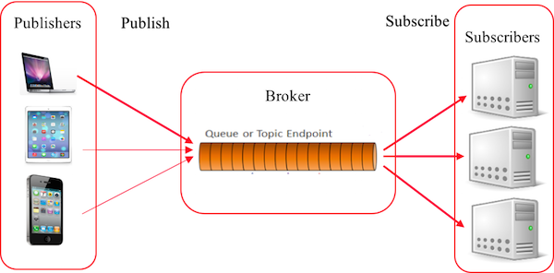
MQTT protocol is based on publish/subscribe architecture. The publish/subscribe architecture consists of three major components: publishers, subscribers, and a broker. According to IoT point of view, publishers are lightweight sensor devices that send their data to connected broker and goes back to sleep whenever possible. Subscribers are applications, which are interested in a certain topic or sensory data, so they are connected to brokers to be informed whenever new data are received. The broker receives the sensory data and filters them in different topics and sends them to subscribers according to interest in the topics.

Slide 8
SMQTT (Secure Message Queue Telemetry Transport)
SMQTT (Secure Message Queue Telemetry Transport) is an extension of MQTT protocol which uses encryption based on lightweight attribute encryption. The main advantage of this encryption is that it has a broadcast encryption feature. In this features, one message is encrypted and delivered to multiple other nodes. The process of message transfer and receiving consists of four major stages:
Setup: In this phase, the publishers and subscribers register themselves to the broker and get a secret master key.
Encryption: When the data is published to broker, it is encrypted by broker.
Publish: The broker publishes the encrypted message to the subscribers.
Decryption: Finally the received message is decrypted by subscribers with the same master key.

Slide 9
DDS
DDS (Data Distribution Service) is a middleware (sometimes called machine-to-machine (M2M)) communication protocol. It is implemented by the Object Management Group (OMG) standard for the real-time system with high speed and high-performance, scalable, dependable, and interoperable data exchange. This communication protocol is based on a publish-subscribe pattern for sending and receiving data, events, and commands among the nodes.
The DDS protocol has two main layers:
Data-Centric Publish-Subscribe (DCPS): This layer delivers the information to subscribers.
Data-Local Reconstruction Layer (DLRL): This layer provides an interface to DCPS functionalities, permitting the sharing of distributed data amongst IoT enabled objects.

